Slide 1
The West
Aim: Did visions of the West match the realities of Westward settlement?

Slide 2
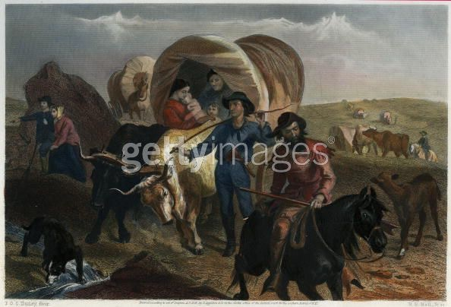
Imagining the West

Slide 3
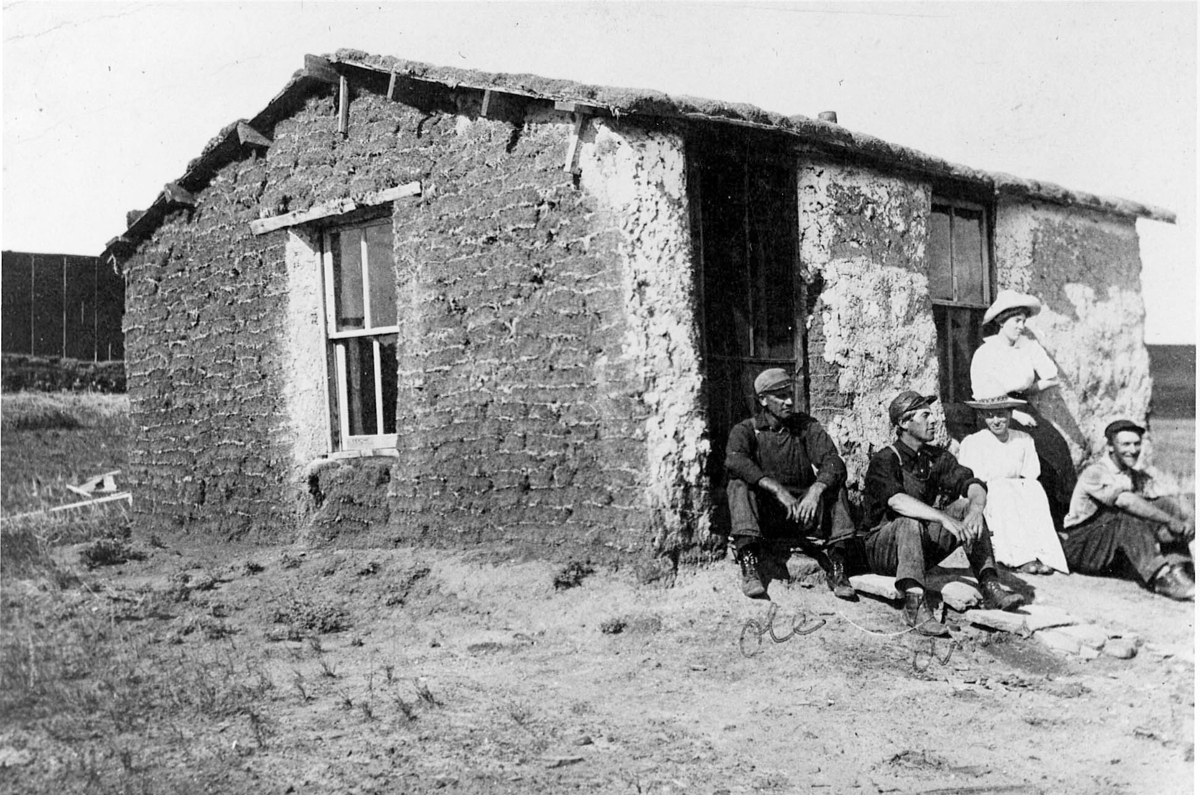
Realities of Westward Settlement

Slide 4
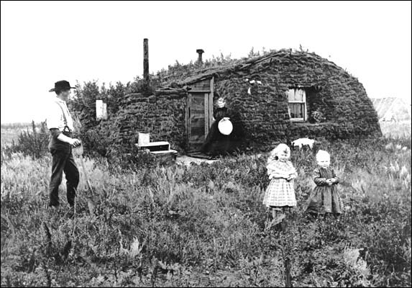

Slide 5
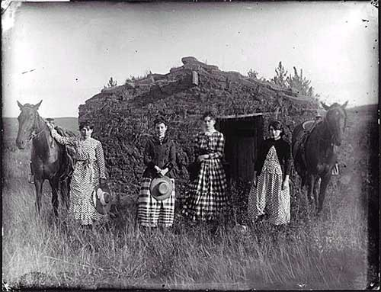

Slide 6
I. Land Fever
Gov’t gave land grants to RRs
Morrill Land-Grant College Act – set aside public land for universities
Homestead Act (1862)
160 acres free to any citizen or prospective citizen who agreed to settle and farm the land for 5 years
Pacific Railway Act - Transcontinental RRs opened up new areas for settlement
Homesteaders faced many hardships
Poor farmers, called “Sodbusters,” lived in sod dugouts
Women and men completed hard manual labor to survive

Slide 7
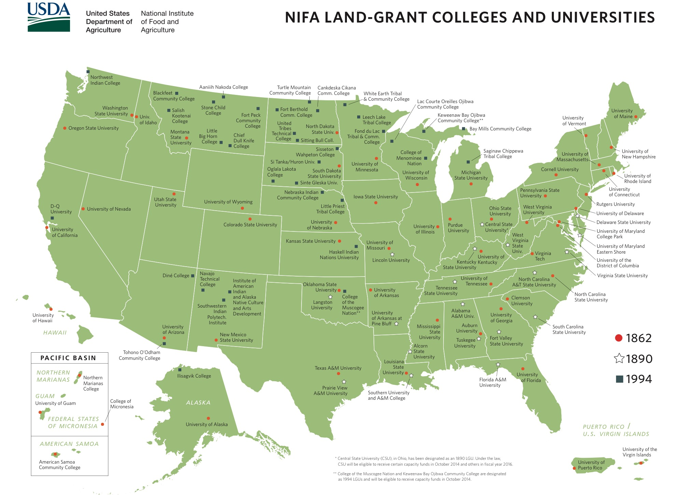

Slide 8
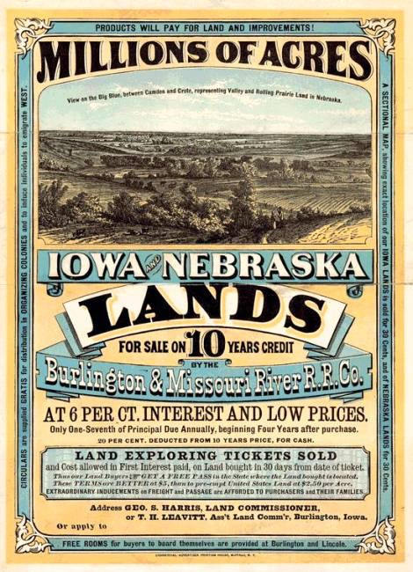

Slide 9
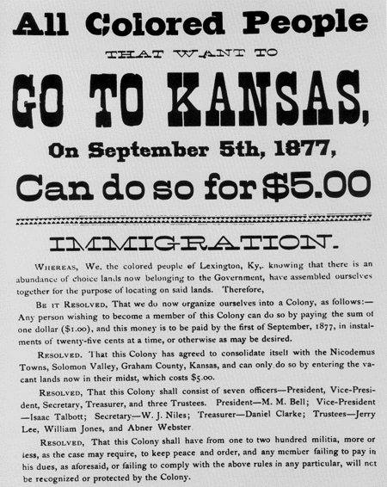
II. Exodusters
To escape the slave-like conditions in the South, 50,000 blacks organized a mass migration, or exodus, to Kansas

Slide 10
III. Gold Fever and the Mining West
Mining (“boom towns”)
California Gold – 1849
Comstock Lode, NV – 1859
Complex communities develop

Slide 11
IV. Ranchers, Cowboys, and Commercial Farming
“Long Drive” to RRs, then to Chicago
Barbed Wire revolutionized cattle business
In TX, fights broke out b/w ranchers and “fence cutters”
Socioeconomic ladder – cattle kings at top with cowboys and wage laborers (many African American)
Agribusiness – farming as a big business, largely mechanized

Slide 12
V. Frederick Jackson Turner’s “Frontier Thesis”
The frontier had shaped American character
Frontier was a safety valve for the east and promoted equality, individualism, inventiveness, etc.
By 1890, he argued, frontier no longer existed (census)

Slide 13
VI. Impacts on American Indians in the West
Battle of Little Bighorn: Sometimes called Custer’s Last Stand, it is the most famous victory of American Indian forces over the U.S. military (although not the largest in death toll). The Sioux killed over 260 troops and their leader, Lt. Colonel George Armstrong Custer. The Sioux were hunted down and killed by other U.S. forces. See: Northwest Indian War, Blue Turtle.
George Custer: A Lt. Colonel who marched his column of men deep into Sioux territory only to discover some 2,500 Sioux warriors waiting for them at the Little Big Horn River. He and his men were then destroyed at the Battle of Little Bighorn—also known as Custer’s Last Stand.
Ghost Dance movement: A Dakota Sioux movement that began in 1870. It intended to bring about a rebirth of native tradition and a repulsion of white incursion. As part of the U.S. government’s efforts to suppress it, the respected Sioux leader Sitting Bull, was killed.
Battle of Wounded Knee: A massacre of over 200 American Indian men, women, and children that took place in December 1890 in South Dakota. Over 20 soldiers involved were awarded the Medal of Honor.

Slide 14
VII. Native American Policy
Dawes Act (1887)
Attempt to Americanize the Native Americans (forced assimilation)
Broke up tribes and granted land directly to Indians as individuals or families
Granted land deeds and citizenship to Native Americans who abandoned tribal ways
Reduced size of Indian population and left them impoverished
Boarding Schools
Forced Native Americans to assimilate into American society
i.e., Carlisle
Century of Dishonor
Exposed to the public the American government’s mistreatment of Native Americans

Slide 15
VII. Native American Policy
Indian Wars
Nearly 400 treaties with Indians had been broken by whites
1864 – Sand Creek Massacre
1866-Red Cloud War
1876-Battle of Little Big Horn
1890-Battle of Wounded Knee

Slide 16
Competing Visions
INEVITABLE PROGRESS OR UNJUST INVASION?
The white men claim this mother of ours, the Earth, for their own use, and fence their neighbors away from her, and deface her with their buildings and their refuse. They destroy all who are in their path.
— Sitting Bull, 1877
The Indians will be eliminated by the progress of the more energetic and aggressive Anglo Saxon . . . a higher and more civilized race.
— William Blackmore, 1877
Was American settlement of the West inevitable progress or unjust invasion, or something in between?

