Slide 1
Populism and Progressivism
A Response to Industrial America

Slide 2
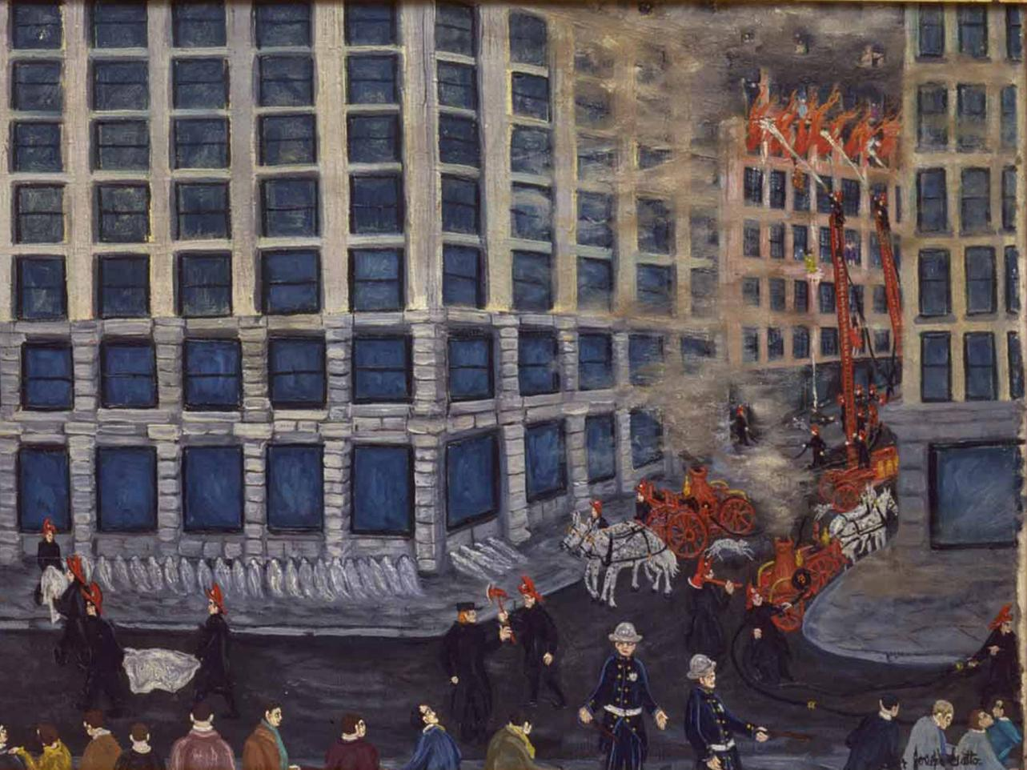
What areas of American society were in need of reform?
Notes:
Chapter Opener: Victor Gatto, Triangle Fire, March 25, 1911 (1944) (page 531)
Text Excerpt: The memories of this horrific scene never left 18-year-old Victor Gatto, who stood on the corner and watched as women plunged directly onto the pavement. In 1944 Gatto, a self-taught artist, painted Triangle Fire: March 25, 1911. His painting depicted a woman plunging to her death past unprepared firefighters atop ladders too short to reach the victims above. On the ground indifferent police officers stand near the neat row of shroud-covered corpses that lined the sidewalk.
Background:
The Triangle Shirtwaist Fire received national press attention because the tragedy exemplified several workplace problems of interest to Progressive reformers. Most of the victims were young immigrant women, illustrating the exploitation of immigrants and the relative powerlessness of women. They worked long hours six days a week (the fire occurred at 4:40 pm on a Saturday afternoon) in unsafe conditions. These women had tried without success to use collective action to better their working conditions. In 1909–10 the women had joined a strike of 20,000 female garment workers to demand higher wages, fire escapes, and unlocked doors—some lost their jobs for joining a union. To support the workers’ demands middle-class female Progressive reformers had tried without success to convince the city to mandate fire drills. In the wake of the fire they pointed out that the building had suffered hardly any damage, thanks to recent city regulations that required the use of fireproof materials for new building construction. The city, they charged, was willing to use regulation to protect property but not workers. Despite the heavy press coverage, change came slowly. The Triangle Shirtwaist Factory owners eventually paid victims’ families $75, while a coalition of unions collected $30,000 to distribute to them. The National Women's Trade Union League sent out surveys to the city’s factory workers to assess fire safety issues in other factories, and the state also sent inspectors into factories to gather evidence of unsafe working conditions. Improved state and city safety regulations followed (such as fireproof stairways, working fire escapes, and the inspection of older multi-storied buildings) as well as laws that improved working conditions for working women that included rest periods, limited hours, and improved sanitation (a cigarette thrown onto mounds of oily fabric scraps was believed to be the reason why the fire spread so quickly).
Chapter Connections:
Competing Visions over whether increasing the regulatory power of local governments or making it easier for workers to organize unions is the best way to prevent tragedies like the Triangle Shirtwaist Factory Fire.
Competing Visions over the rising faith in scientific expertise: the Progressive desire to undertake systematic surveys of working conditions and then create informed laws to protect workers versus industrialists’ interest in using scientific management to exert more control over workers.
Competing Visions over the rights of property owners versus the concern for the public good.
Discussion Questions:
What interpretation of the 1911 Triangle Shirtwaist Factory Fire did the painting offer?
What problems in addition to safety issues did the fire reveal?
What different solutions might Progressive reformers, unions, or factory owners offer to these problems?

Slide 3
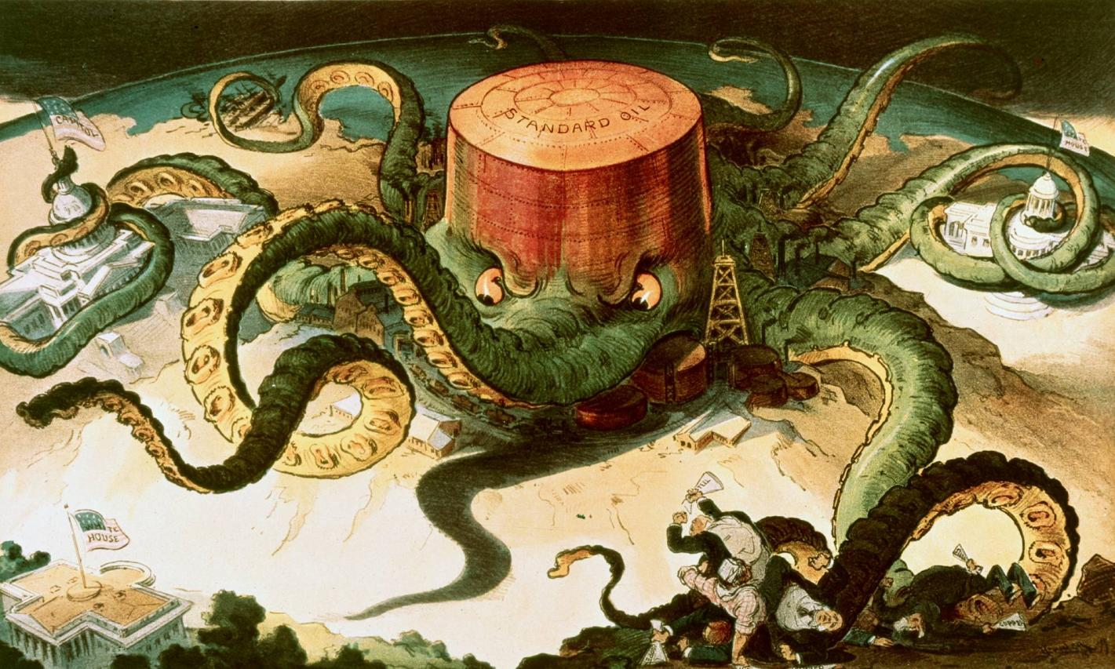
Notes:
Image 18.3: Standard Oil’s Tentacles
In this political cartoon Standard Oil is an octopus, consuming everything in its path.

Slide 4
Growth of Cities

Slide 5
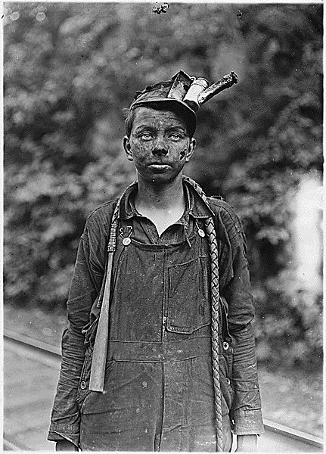
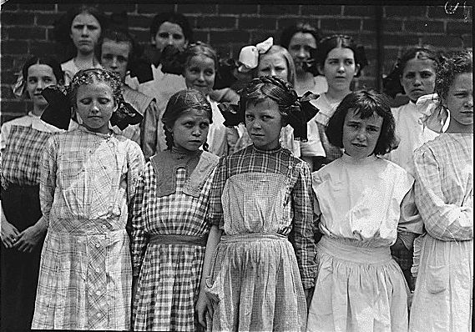
CHILD LABOR
Photography by Lewis Hine – was instrumental in changing laws

Slide 6
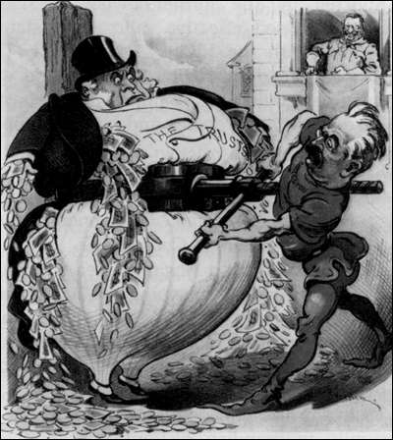
The Progressive Answer

Slide 7
Characteristics
Never a single group seeking a single objective – many sources
Fought corruption and inefficiency in gov’t
Attempted to regulate and control big business
Concern for urban poor
Scientific management – scientific analysis of human activity
Dealt with issues concerning local, state and federal gov’t.
Change sought from below first, then gov’t takes on reforms
General prosperity encouraged middle class to support reform measures without feeling “radical”
NEVER CHALLENGED THE FUNDAMENTAL PRINCIPLES OF CAPITALISM

Slide 8
The Origins of Progressivism
The depression of the 1890s, labor unrest and the populist revolt led many Americans to seek new answers to society’s ills, turning to citizen organizations and government for action.
Progressivism drew from deep roots in American communities and spread, becoming a national movement, peaking in the election of 1912.
The Progressive impulse began at the local and state levels, and, with leaders like La Follette, Johnson, Roosevelt and Wilson, moved to the national level.
Both political parties were reshaped by Progressivism.

Slide 9
The Progressives’ Limited Progress
Lochner v. New York (1905) – A Supreme Court ruling that unless long work hours directly jeopardized workers’ health, the government could not abridge an employee’s freedom to negotiate his own work schedule with his employer
Rehabilitating Lochner: Defending Individual Rights against Progressive Reforms

Slide 10
Regulating Work Conditions
Muller v. Oregon (1908), The case upheld Oregon state restrictions on the working hours of women as justified by the special state interest in protecting women's health.
Mixed feelings for those involved in Women’s movement.

Slide 11
The Progressives’ Limited Progress
Ludlow Massacre – Colorado state troops set a striking miners’ camp ablaze, killing thirteen women and children, an act that outraged laborers throughout the nation.

Slide 12
Triangle Shirtwaist Fire
March 25, 1911
146 died, mostly immigrant women
Average age =19
Led to labor reform in New York State
Also spurred reform of city government

Slide 13
Triangle Shirtwaist Fire Aftermath

Slide 14
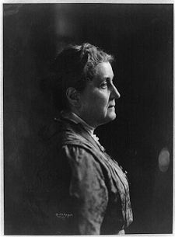
Urban Reformers
Well-educated young women and men hoped to relieve the effects of poverty by providing social services for people in the neighborhood.
Most famous of this experiment was Hull House in Chicago – opened by Jane Addams in 1889
Florence Kelley
Her reports pushed legislation for the eight-hour work day for women and child labor laws in Illinois.

Slide 15
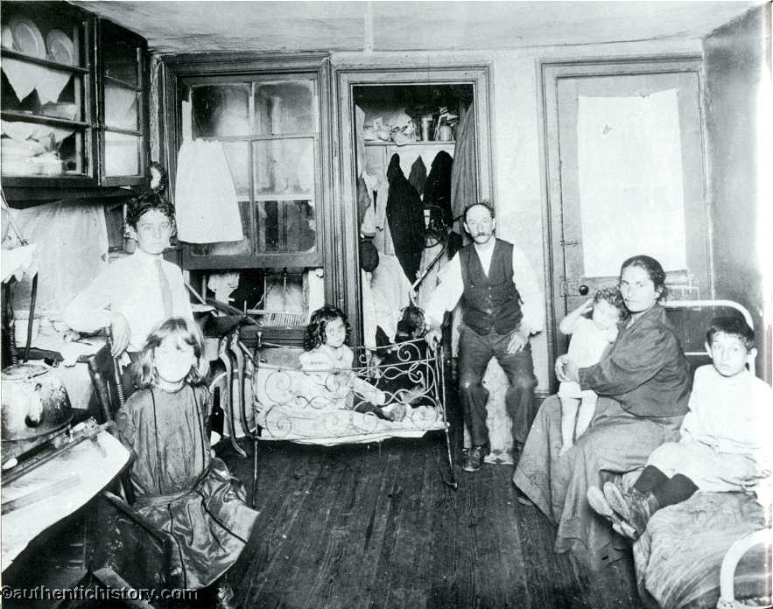
Urban Reformers
Jacob Riis – How the Other Half Lives – Chronicled Urban Poor

Slide 16
Political Reforms – State/Local
Attempt to reform state and local governments
Referendum
Recall
Initiative
City Manager System
Commission government

Slide 17
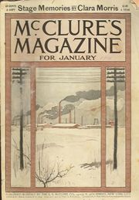
Muckrakers
Phrase coined by Teddy Roosevelt
Investigative journalists
Mobilized national opinion
Ida Tarbell – Standard Oil
Lincoln Steffens – big city politics
Upton Sinclair – “The Jungle”
Led to Pure Food and Drug Act

Slide 18
New Journalism: Muckraking
A new breed of investigative journalist began exposing the public to the plight of slum life, pioneered by McClure’s Magazine.
Muckrakers published accounts of urban poverty, and unsafe labor conditions, as well as corruption in government and business.

Slide 19
Federal Laws
Pure Food and Drug Act (1906) – Law levied federal fines for mislabeling food or medicine

Slide 20
Constitutional Amendments
Largest group of amendments in 7 year period since the Bill of Rights was passed
16th - Income Tax
17th - Direct election of senators
18th – Prohibition
19th – Women’s Suffrage

Slide 21
Prohibition
Led by Anti-Saloon League and Women’s Christian Temperance Union
Proponents included women’s reformers and industrialists
By 1916 19 states had already banned sale and manufacture of alcohol

Slide 22
Prohibition Map

Slide 23
Prohibition
Became wartime issue
Anti-German sentiment – “Kaiser Beer”
Congress passes Amendment Dec. 1917
President Wilson institutes partial ban to conserve grain
Went into effect1/16/20

Slide 24
Prohibition
Prohibition linked to other progressive amendments
Income tax would make up for lost revenue from liquor tax
Women voters would support politicians who voted for 18th Amendment

Slide 25
Revival of Women’s Suffrage Movement and Birth of Feminism
Women’s Suffrage
Protest March

Slide 26
Anti-19th Amendment Propaganda

Slide 27
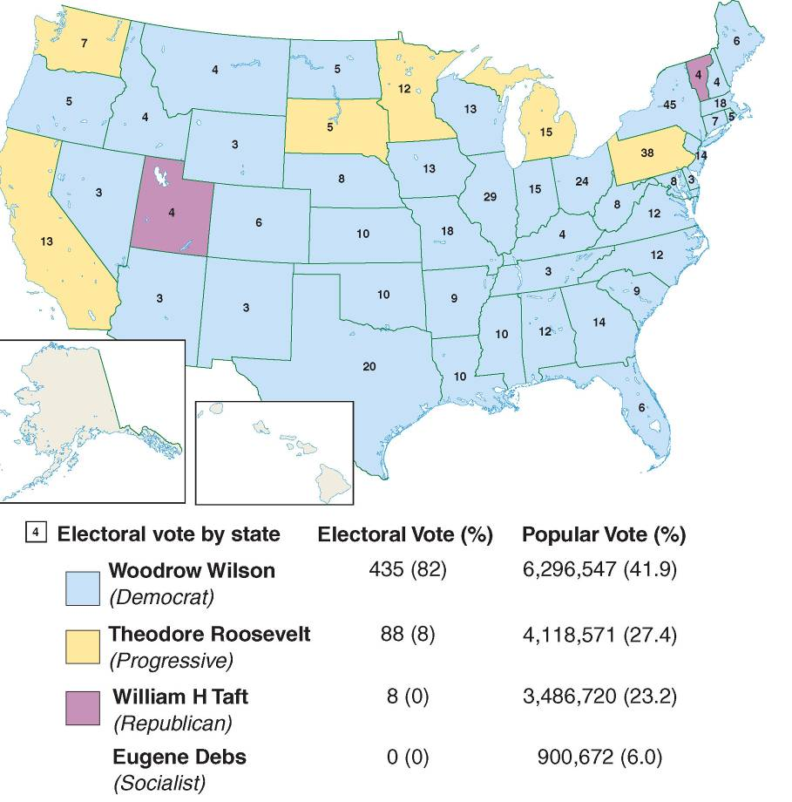
Notes:
Image 18.4: 1912 Presidential Election Results
Strong third-party challenges from the Progressive Party and Socialists split the national vote four ways, but Democrat Wilson prevailed to win the presidency in 1912.

Slide 28
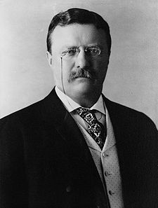
The Progressive Presidents – Who was the “Most Progressive”

Slide 29
The Progressive Presidents
TR earns reputation as a “trustbuster”
Often worked around Congress and expanded Presidential power
Roosevelt viewed the presidency as a “bully pulpit” to promote progressive reforms.
He pressured mine owners into a settlement that won better pay for miners.
Taft worked within constitutional structure and was seen as less effective
Wilson “The Professor” – Effective but limited in viewpoint - refused to support women’s vote, low interest loans to farmers, or exempt unions from anti-trust laws

Slide 30
Trust-busting and Regulation
Roosevelt favored passing regulatory laws including:
Hepburn Act: strengthened the Interstate Commerce Commission
Pure Food and Drug Act
Meat Inspection Act
“Trustbuster”: justice department to prosecute monopolies
TR considered government regulation the best way to deal with big business.

Slide 31
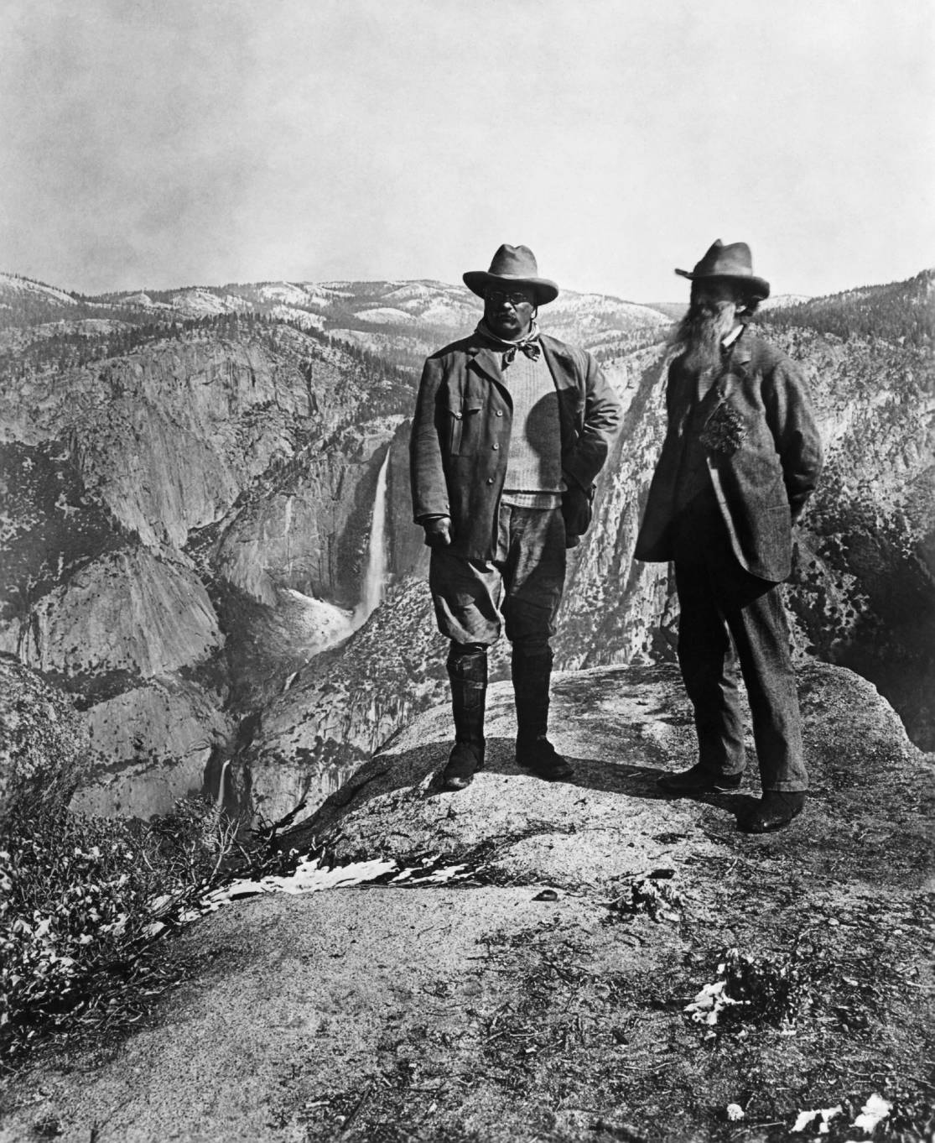
The Birth of Environmentalism
Roosevelt believed that the conservation of forest and water resources was a national problem of vital import.
Along with Forestry Department head Gifford Pinchot, Roosevelt withdrew millions of acres of public land from development
Notes:
Image 18.5: John Muir and President Roosevelt in Yosemite, 1903
Despite their camaraderie during a shared camping trip, Muir and Roosevelt embraced competing environmental visions.

Slide 32
William Howard Taft
Hand-picked by Roosevelt
Pushed decisions on trusts back to the courts
Split with Roosevelt of tariff, trusts and other issues

Slide 33
The Election of 1912: A Four-Way Race
Reforming New Jersey Governor Woodrow Wilson won the Democratic nomination.
Woodrow Wilson promoted his New Freedom platform crafted by Louis Brandeis.
The Socialist Party, which had rapidly grown in strength, nominated Eugene Debs, who got 6% of the vote.
Wilson won 42 percent of the vote, enough to defeat the divided Republicans and sweep the Electoral College.

Slide 34
Election of 1912
Wilson (D), Taft (R)
Roosevelt (P) “Bull Moose”, Debs (Socialist)
Roosevelt’s “New Nationalism” vs Wilson’s “New Freedom”
Wilson crushes BUT Roosevelt and Taft get a million more combined, plus Debs got a million votes also

Slide 35
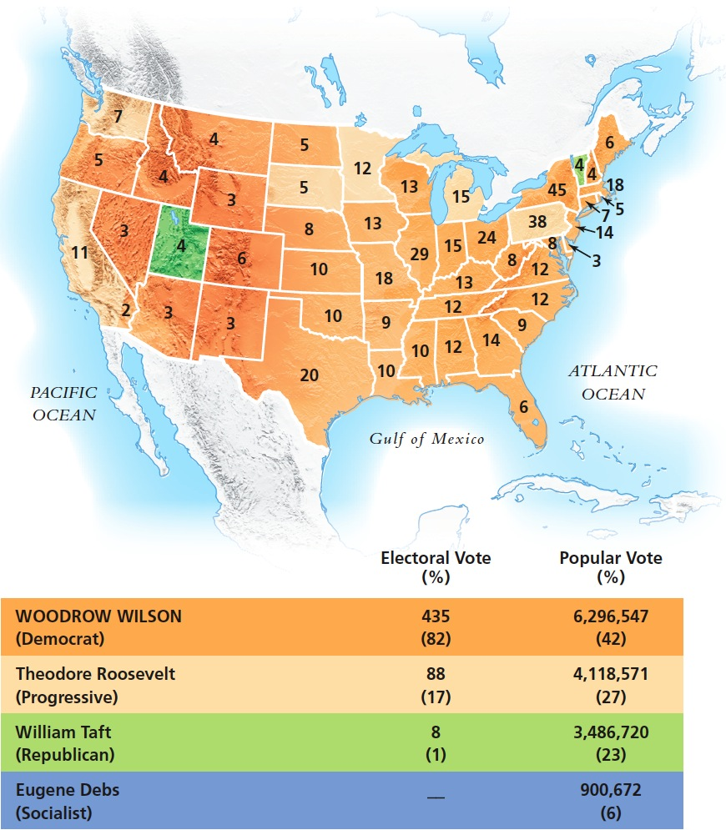
MAP 21.2 The Election of 1912
Notes:
MAP 21.2 The Election of 1912
The split within the Republican Party allowed Woodrow Wilson to become only the second Democrat since the Civil War to be elected president. Eugene Debs’s votes were the highest ever polled by a socialist candidate.

Slide 36
Woodrow Wilson’s First Term
Wilson followed Roosevelt’s lead in promoting an activist government by:
lowering tariffs(Underwood Tariff)
pushing through a graduated income tax,
restructuring the banking and currency system under the Federal Reserve Act.
expanding the nation’s anti-trust authority and establishing the Federal Trade Commission.

Slide 37
Woodrow Wilson’s Progressive Vision
Federal Reserve Act (1913) – Created a federally run Federal Reserve to serve as a “banker’s bank” that held a portion of bank funds in reserve to help member banks in time of crisis, set rates for business loans, and issued a new national paper currency
Clayton Anti-Trust Act (1914) – Prohibited interlocking company directories and exempted trade unions from prosecution under the 1890 Sherman Anti-Trust Act
More limited on social reform, Wilson also ordered the segregation of the federal work force

Slide 38
Effect of Progressive Era
Very poor record on minority rights
Created modern banking structure
Made society more democratic
Questioned the size and scope of “big business”
Did not challenge the fundamentals of capitalism
Precursor to the New Deal

Slide 39
Books on the Progressive Era
TR
Election of 1912

