Slide 1
European Encounters

Slide 2
III. European Encounters
Christopher Columbus persuaded the Spanish to support his expedition on their behalf.
On October 12, 1492, he and his crew landed on an island in the Bahamas.
Columbus called the native peoples “Indians.”
Columbus’s discovery convulsed four continents—Europe, Africa, and the two Americas.
An independent global economic system emerged.
The world after 1492 would never be the same.

Slide 3
Columbian Exchange

Slide 4
III. European Encounters
European conquest driven by mercantile capitalism and Christianity
Printing press, word spread rapidly of Columbus’s voyage and discovery—more colonizers arrived.
Europeans easily dominated native peoples because of more advanced technology, science, and commerce.
As colonizers came over, they introduced weeds, vermin, and deadly microbes, which greatly damaged the native peoples
- virulent pathogens proved to be the most deadly force in exterminating the native Americans (present in Europe b/c of industrialization, animal domestication, and long-distance travel); e.g., Hispaniola pop. in 1492 – 300,000; pop. in 1548 - 500

Slide 5
How did Europeans view the Indians?
[The Indians] brought us parrots and balls of cotton and spears and many other things, which they exchanged for the glass beads and hawks’ bells. They willingly traded everything they owned…. They were well-built, with good bodies and handsome features…. They do not bear arms, and do not know them, for I showed them a sword, they took it by the edge and cut themselves out of ignorance. They have no iron. Their spears are made of cane…. They would make fine servants…. With fifty men we could subjugate them all and make them do whatever we want.
–Christopher Columbus, 1492

Slide 6
How did Europeans view the Indians?
The barbarians... have a lawful, just, and natural government. Even though they lack the art and use of writing, they are not wanting in the capacity and skill to rule and govern themselves, both publicly and privately. Thus, they have kingdoms, communities, and cities that they govern wisely according to their laws and customs. Thus their government is legitimate and natural, even though it has some resemblance to tyranny. From these statements we have no choice but to conclude that the rulers of such nations enjoy the use of reason and that their people and the inhabitants of their provinces do not lack peace and justice. Otherwise they could not be established or preserved as political entities for long…
From the fact that the Indians are barbarians it does not necessarily follow that they are incapable of government and have to be ruled by others, except to be taught the Catholic faith and to be admitted to the holy sacraments…
--Bartolome de Las Casas, 1552

Slide 7
“...the whole of the North American continent was six thousand years behind European civilization. It was only inhabited by Red Indians, and not more than a million of them, while long stretches of wild meadow and primeval forest, extending like years into the distance, had no human dwellers at all. A wildly beautiful land, enormously fertile, carrying but a million Indians -- it is difficult to conceive now.”
John Stewart Collis, The Vision of Glory: the Extraordinary Nature of the Ordinary (London: Penguin Books, 1975)
4. The excerpt would be most useful to historians as a source of information about which of the following?
a. Compiling the population totals of indigenous peoples in the pre-Columbian era.
b. Affirming the role of indigenous peoples in the preservationist movement.
c. Examining the impact of European exploration and colonization on indigenous Americans.
d. The lack of cohesive social and political systems among indigenous Americans.
5. Proponents of the ideas expressed in Collis’ analysis would most likely have agreed with which of the following?
a. Native peoples had the ability to manipulate the environment, but chose not to.
b. The reason why so few Native Americans were in North America was due to the impact of deadly microbes.
c. Great kingdoms like the Mexica and Inca rivaled, and in some cases, surpassed, those in Europe.
d. Europeans brought civilization and cultivation to the Americas.

Slide 8
IV. The Conquest of Mexico and Peru
Spain secured its claim to Columbus’s discovery in the Treaty of Tordesillas (1494), which divided the New World with Portugal.
The West Indies served as offshore bases for staging the Spanish invasion of the mainland.
The encomienda allowed the government to “commend” Indians to certain colonists in return for promise to try to Christianize them.
Spanish missionary Bartolomé de Las Casas called it “a moral pestilence invented by Satan.”
In service of God, in search of gold and glory, Spanish conquistadores (conquerors) came to the New World.

Slide 9
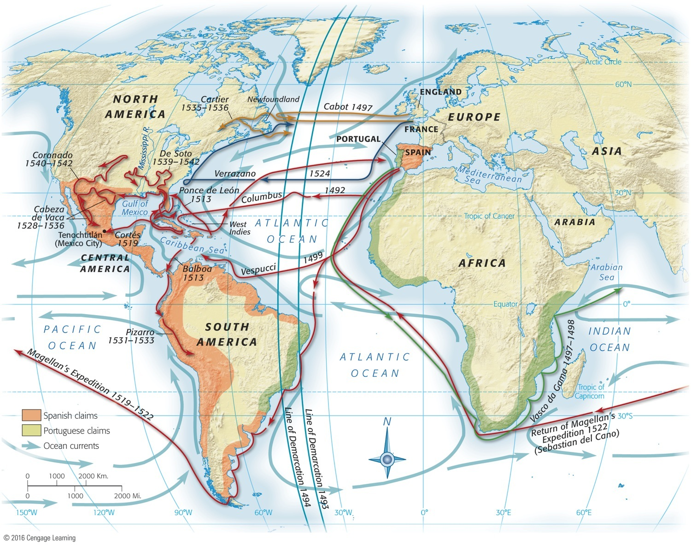
Map 1.4 p17
Notes:
Map 1.4 Principal Voyages of Discovery Spain, Portugal, France, and England reaped the
greatest advantages from the New World, but much of the earliest exploration was done by Italians,
notably Christopher Columbus of Genoa. John Cabot, another native of Genoa (his original name
was Giovanni Caboto), sailed for England’s King Henry VII. Giovanni da Verrazano was a Florentine
employed by France.

Slide 10
V. Exploration and Imperial Rivalry
Other explorers came to the New World:
1497–1498―Giovanni Caboto (known as John Cabot) explored the northeastern coast of North America.
1513: Balboa discovered the Pacific Ocean.
1519: Hernan Cortés set sail with eleven ships for Mexico and her destiny; defeats Aztecs
1519: Magellan rounded tip of South America.
1513 and 1521: Ponce de León explored Florida.
1524―Giovanni da Verrazano probed the eastern seaboard.
1534―Jacques Cartier journeyed up the St. Lawrence River.
1540–1542: Coronado explored Arizona and New Mexico.
1539–1542: Hernando de Soto discovered the Mississippi River

