Slide 1
The Origins of the Cold War

Slide 2
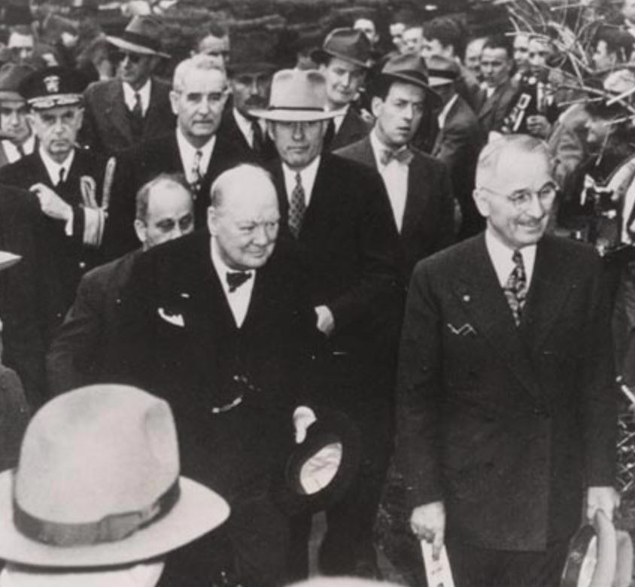
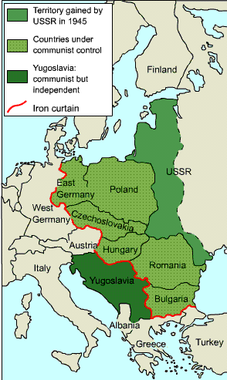
The Iron Curtain
Winston Churchill with President Truman just before the Iron Curtain Speech
Map of the “Iron Curtain”
Notes:
Image on the left retrieved from the Library of Congress: http://www.loc.gov/pictures/item/2004666482/

Slide 3
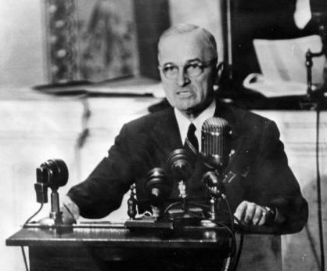
The Truman Doctrine, 1947
President Truman outlined the Truman Doctrine to a joint session of Congress in March of 1947
President Truman in 1945
Notes:
Image on the left retrieved from: https://www.loc.gov/item/96523444/

Slide 4
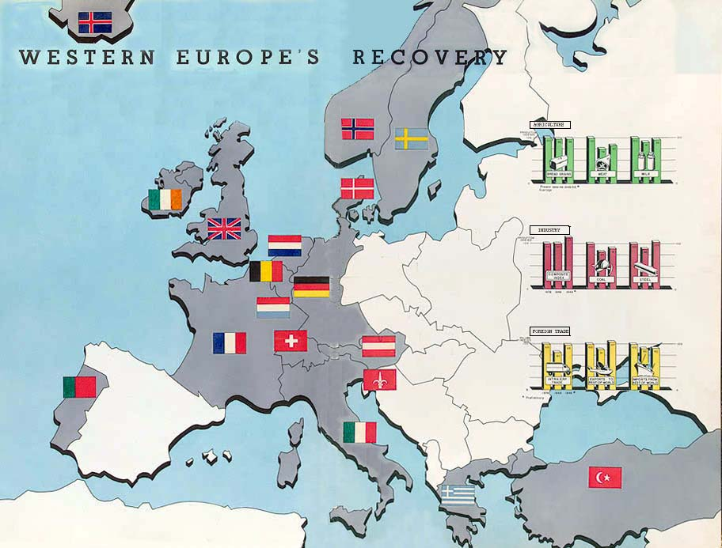
The Marshall Plan, 1947
Nations that had received Marshall Plan aid by 1950
Notes:
Image retrieved from the Library of Congress: http://www.loc.gov/exhibits/marshall/images/wholemap.jpg

Slide 5
Marshall Plan, 1947
Stuttgart, Germany before and after Marshall Plan aid
Notes:
Image retrieved from the Library of Congress: http://www.loc.gov/exhibits/marshall/images/p4647.jpg

Slide 6
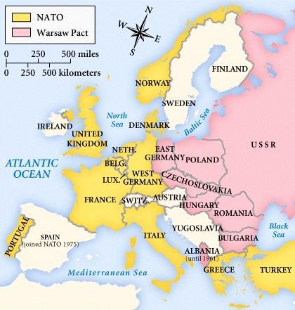
NATO Treaty, 1949. Warsaw Pact, 1955.

Slide 7
Central Historical Question:
Who started the Cold War?

