Slide 1
Foreign Policy in the Early Republic
Did American leaders follow Washington’s advice?

Slide 2
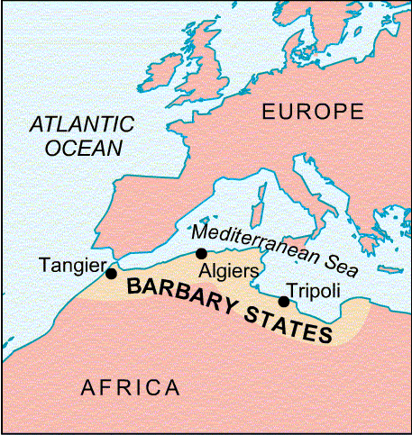
I. Barbary Wars
Fought between the US and the N. African countries known collectively as the Barbary States
After years of fighting, a treaty was signed

Slide 3
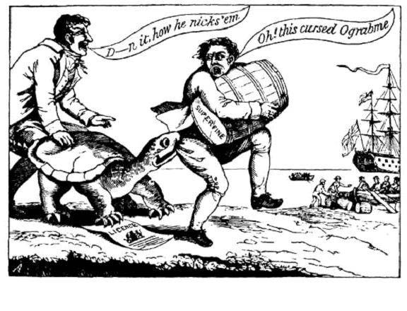
II. Embargo Act, 1807
Prevented US from engaging in foreign trade
Injured US economy and Jefferson’s reputation

Slide 4
III. War of 1812 - Causes
Republican War Hawks call for war.
Issues:
1) Land hunger
2) British impressment – raiding U.S. ships
3) Indian atrocities - British support Shawnee
Despite pleas from New England Federalists to remain calm, James Madison asked Congress for a war declaration on June 18, 1812.

Slide 5
IV. War of 1812 - Results
Treaty of Ghent - American and British agree to end fighting on December 24, 1814
Hartford Convention - Federalist opposition leads to their decline after the war
Battle of New Orleans (1815) - Andrew Jackson
Ushers in wave of American NATIONALISM

Slide 6
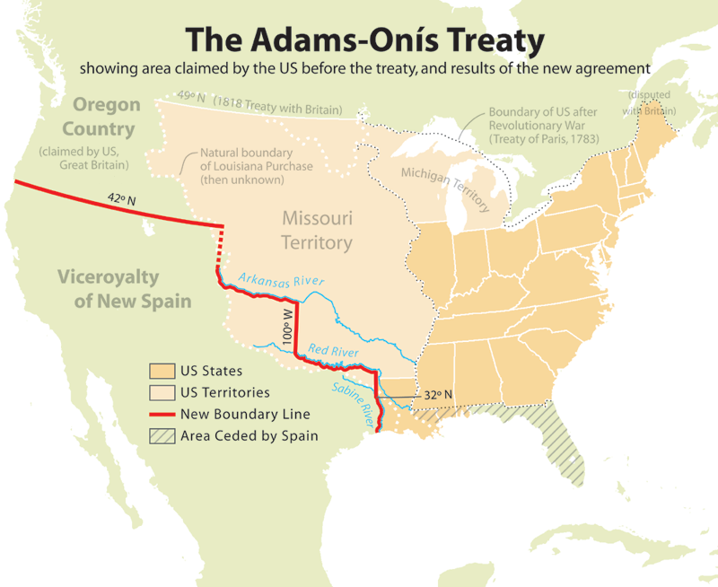
V. Acquisition of Florida
Adams-Onis Treaty (1819) – sets boundary b/w US and Spanish territory; US gets Florida

Slide 7
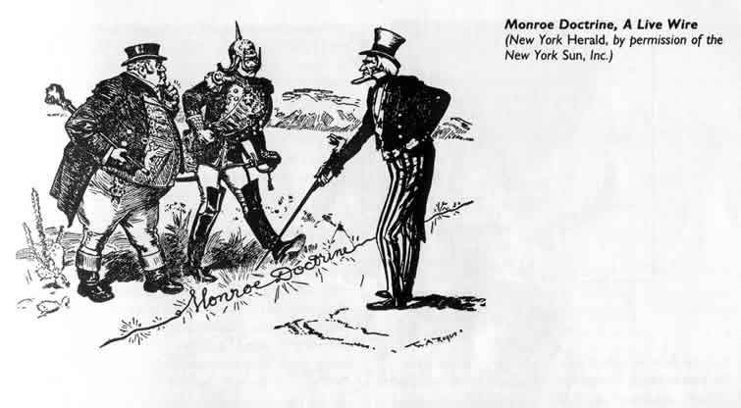
VI. Monroe Doctrine
Reaffirmed American neutrality
U.S. wouldn’t interfere with existing colonies in Western Hemisphere but wouldn’t permit further colonization
Any attempt by a European nation to colonize any area of the Western Hemisphere would be perceived as an act of aggression against the United States

